Slide 1
Final Project Individual
MIS 631: Data Management
Julie Pronier

Slide 2
TABLE OF CONTENTS
01
02
03
BACKGROUND AND GOAL
RETRIEVING DATA
DATASET
04
05
06
OBSERVATION
MAIN RESULTS
CONCLUSION
Problem to solve
Utilization of API
Key Attributes
Data in PgAdmin
Approaches and outcomes
Wrap up and future

Slide 3

THE BACKGROUND…
First ideas from my areas of interest: music
Project in Financial Decision Making about Spotify: Good link
Spotify API: acquiring new competencies
Process of thoughts

Slide 4
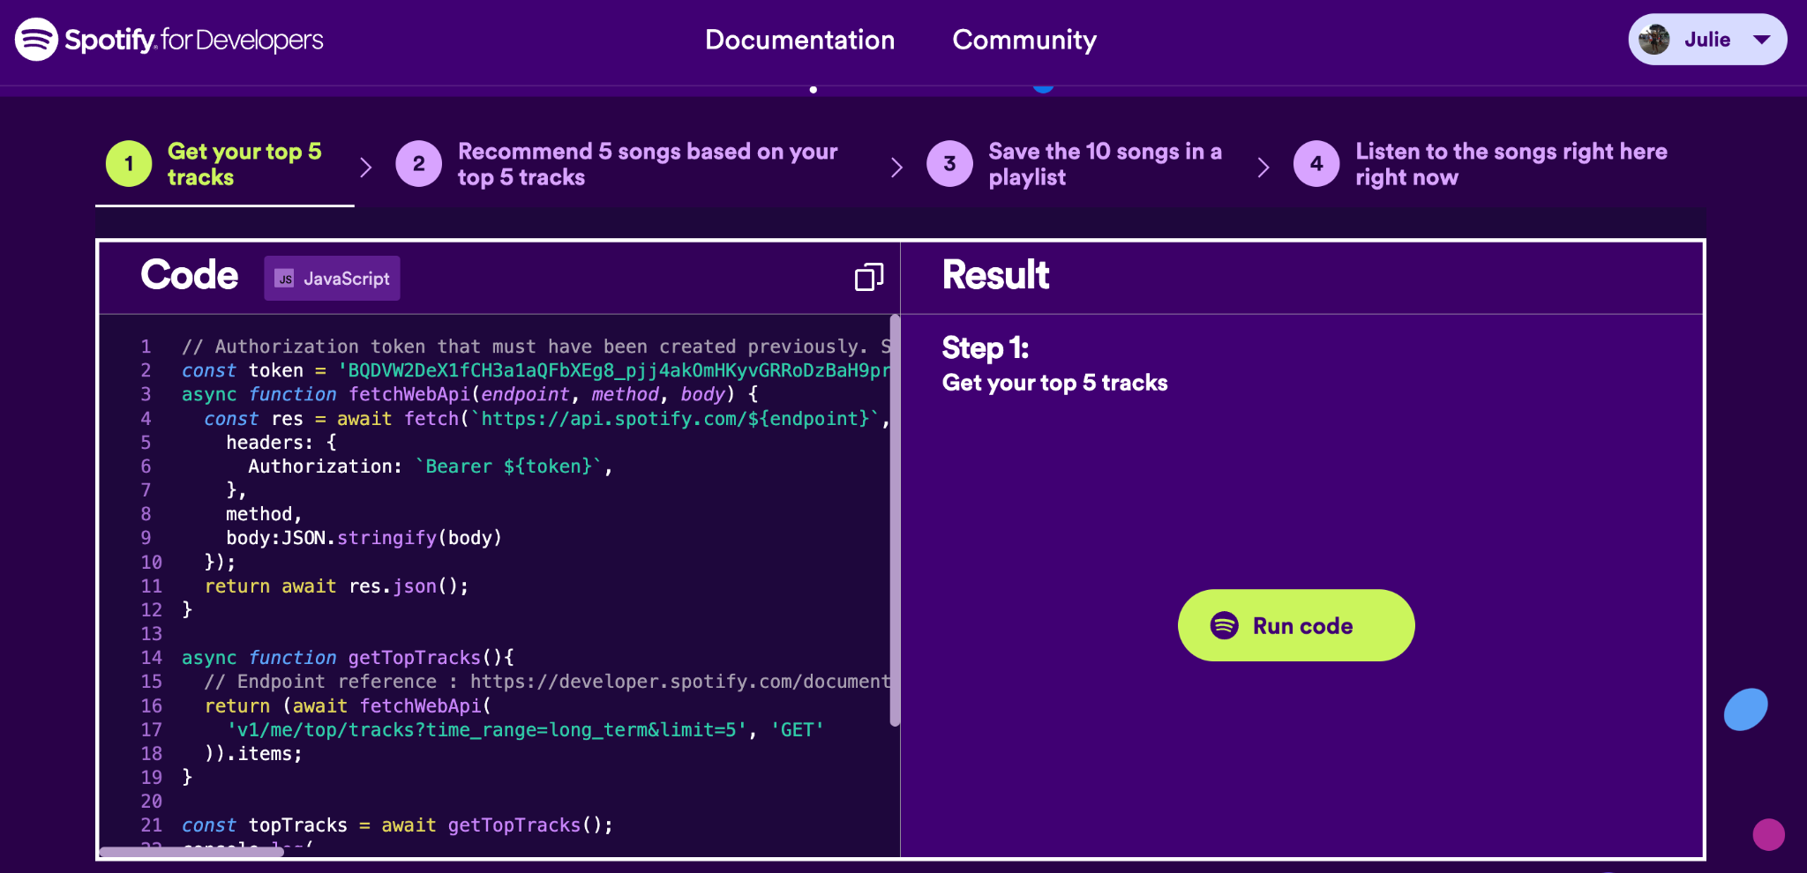
First Interest

Slide 5
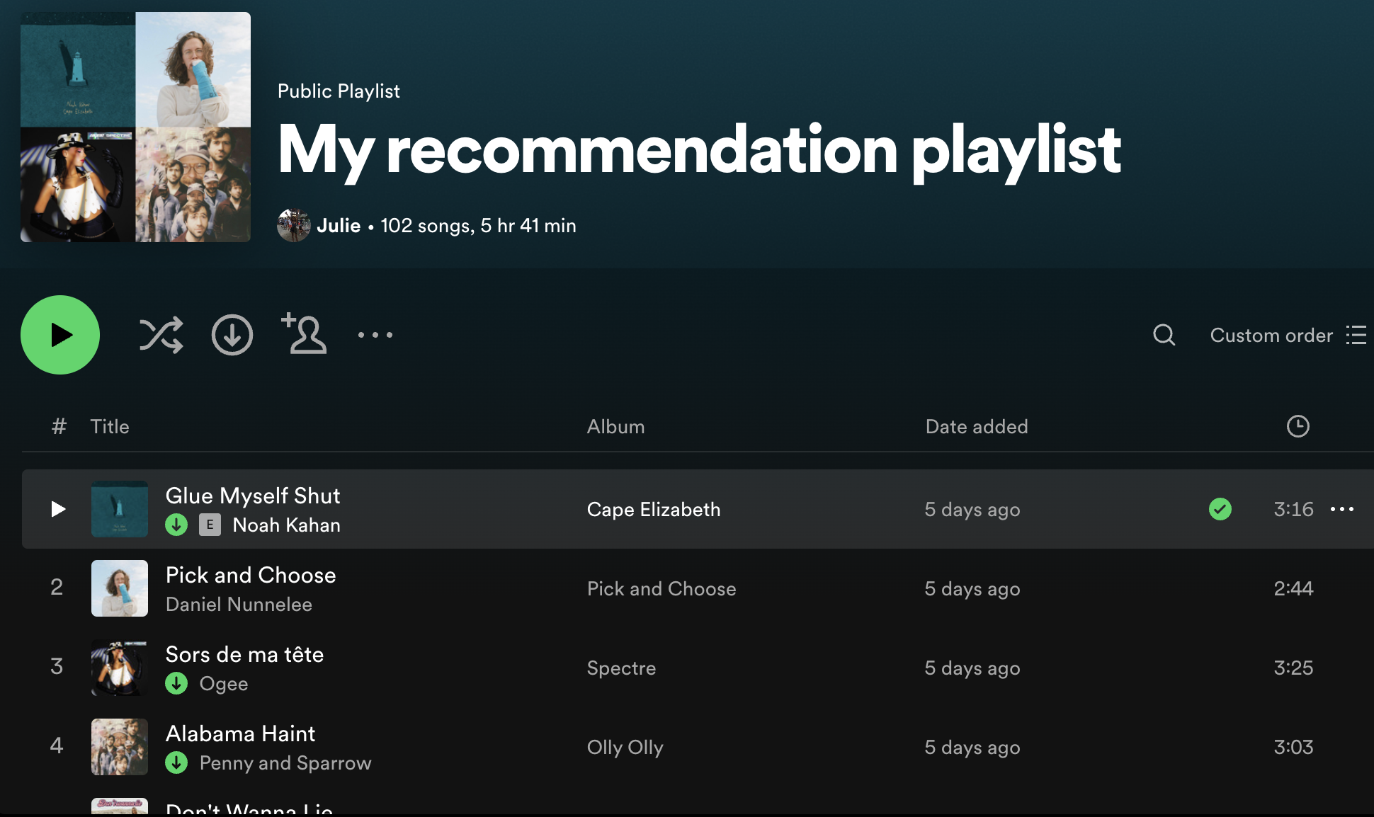
Chosen Data

Slide 6
… AND THE GOALS
Technical
Critical Thinking
Retrieve Data from personalized playlist and be able to manage it
Get insights about my musical tastes

Slide 7

RETRIEVING DATA
Datacamp class about APIs
Understanding the documentation
Get to work, try, fail, solve and repeat !

Slide 8
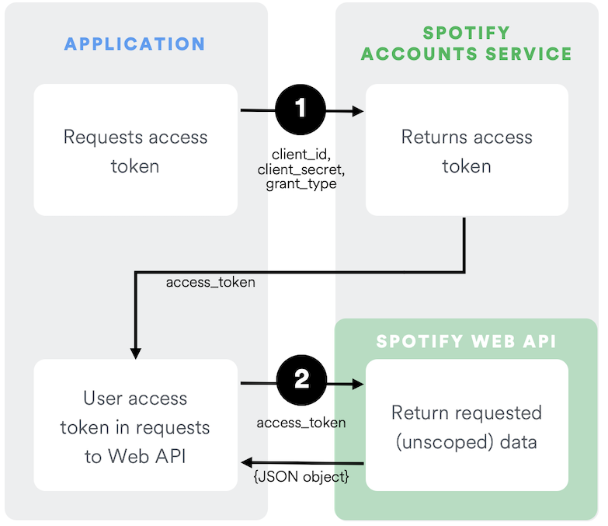
Spotify’s API
Get an account to use client credentials flow
Create App on Developers page
Get Client_id and Client_secret
Code to request access token
Use token to retrieve data

Slide 9
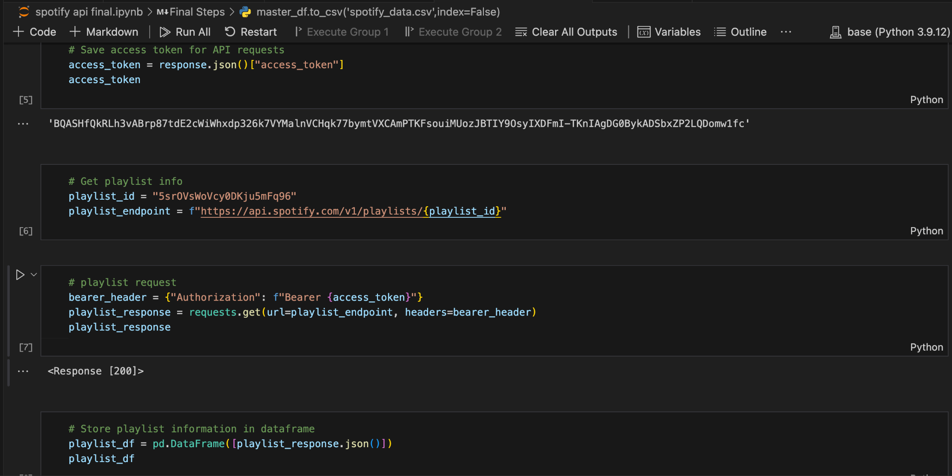
API utilization

Slide 10



THE DATASET
Get INFORMATION
Analyze COLUMNS
KEY ATTRIBUTES
Find the right columns, using pd.json_normalize and explode to work with json type
Sort between irrelevant information for this project and interesting features
With the available columns, determine entities and attributes

Slide 11
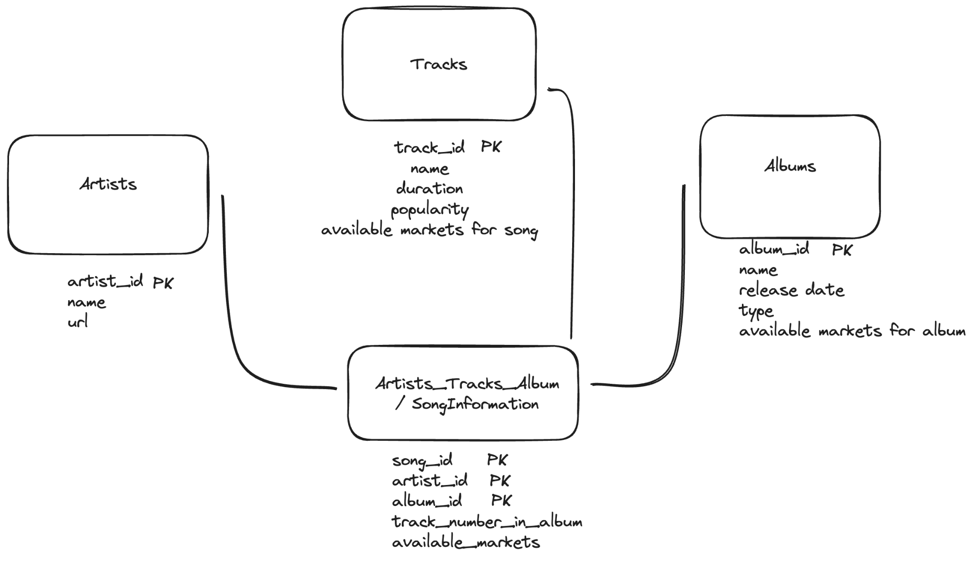
Database Structure

Slide 12
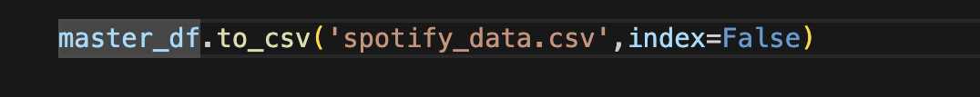
‘spotify_data.csv’
Handle data and rename columns:
CSV file ready to be imported in PgAdmin

Slide 13
IMPORTATION AND OBSERVATION
with PostgreSQL on PgAdmin

Slide 14
DATA HANDLING STAGES
 | IMPORT data | TABLES | CONNEXION
IDEA | Create a ‘master’ table with entire csv | Create album, artists, track, and dynamic using ‘master’ | Add foreign keys to have tables linked
CODE | Drop table then create with right columns | Structure: create as select distinct | Add Constraint foreign key
PROBLEMS | Temporary / Columns types: int, date, list | Alter to add primary keys | Understand provenance and referance

Slide 15
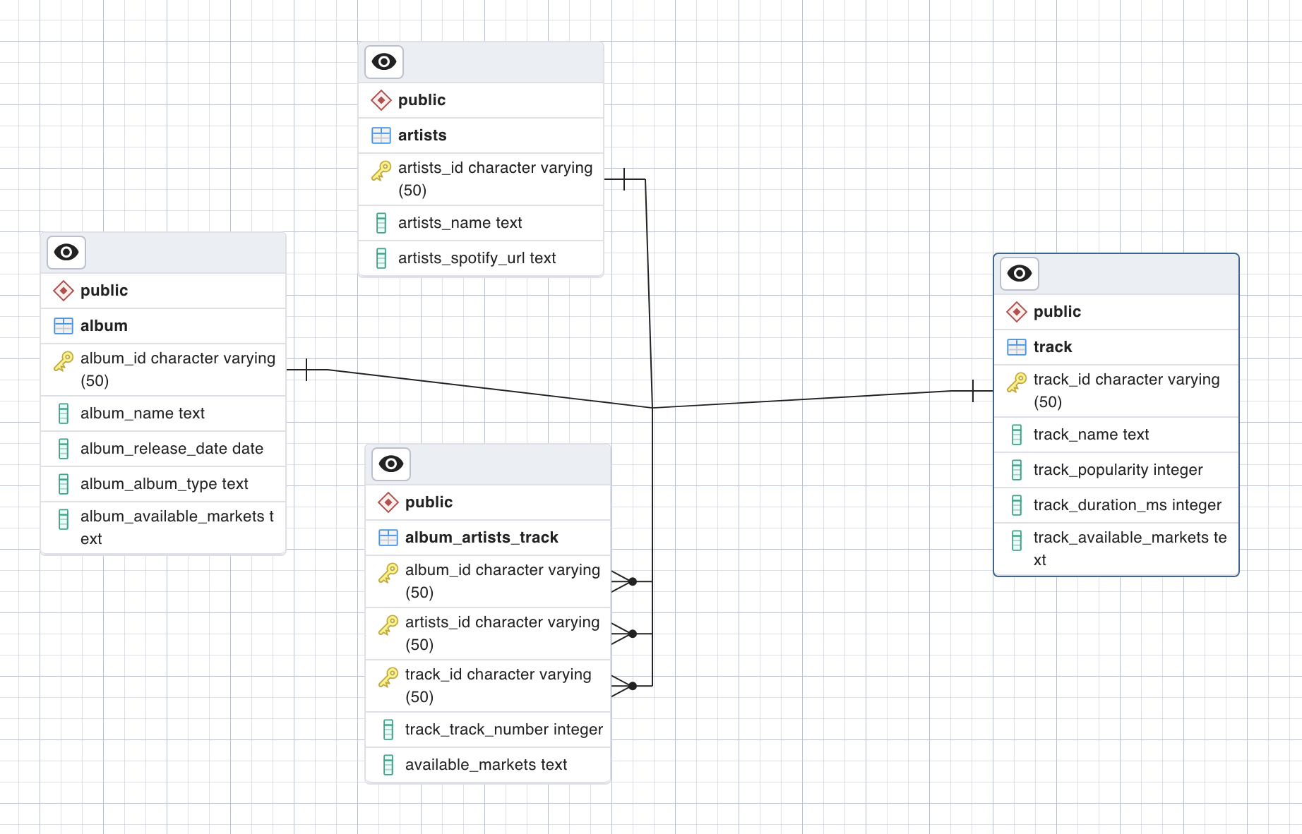
ERD Generated

Slide 16

MAIN RESULTS
Chosen approaches Research questions
and Obtained results

Slide 17
Closer look at Popularity feature
Calculated by Algorithm, mostly based on number of plays and date.
Research Questions
Let’s look at the songs with high popularity: > 80
How many are there ? Who are the artists that made those songs ? How many artists are responsible for them ?
Which song is the most popular? Who made it ? How many songs does this artist have on the playlist ?

Slide 18
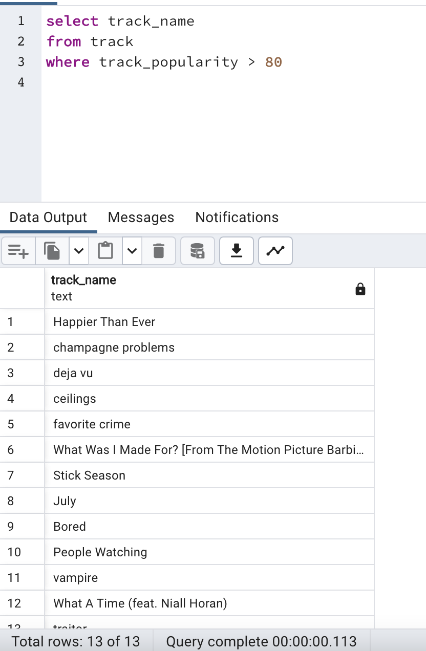
13 songs have popularity higher than 80
Among artists: Billie Eilish, Niall Horan, Noah Kahan
9 Artists are behind the 13 most popular songs of the playlist

Slide 19
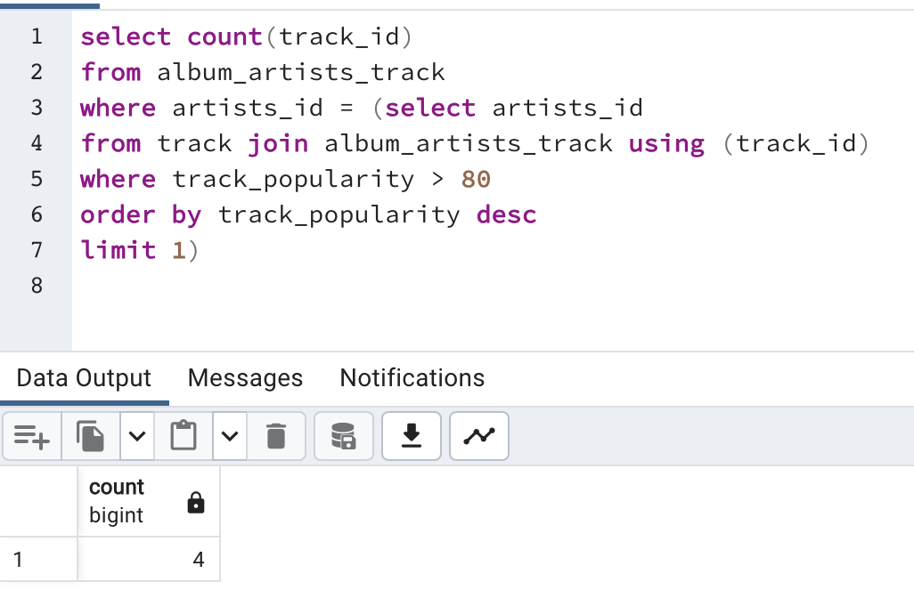
Most Popular song is named ‘Vampire’
The Artist is Olivia Rodrigo
She has 4 songs in total in this playlists

Slide 20
Closer look at Artists characteristics
A lot of interesting aspects can be analyzed about the artists;
Research Questions
Which ones have more songs in this playlist ?
Are there any featurings ?

Slide 21
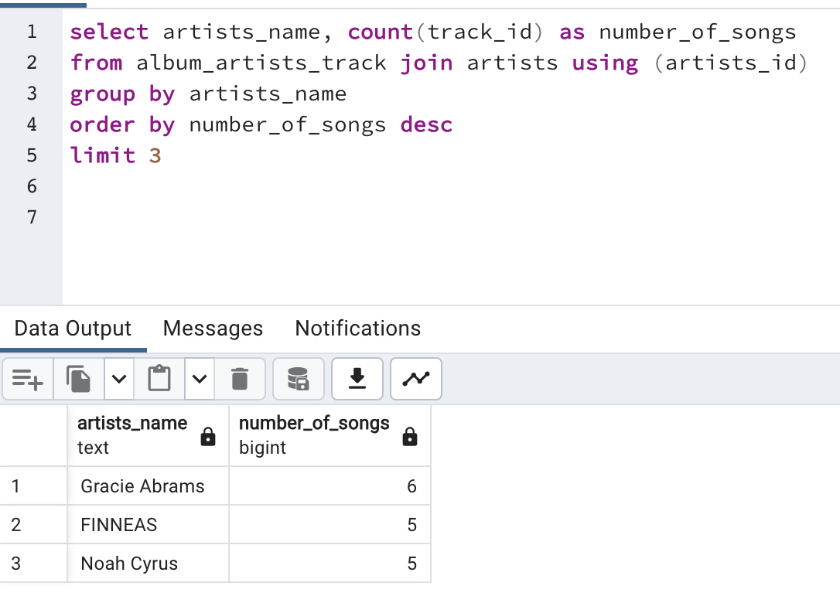

Slide 22
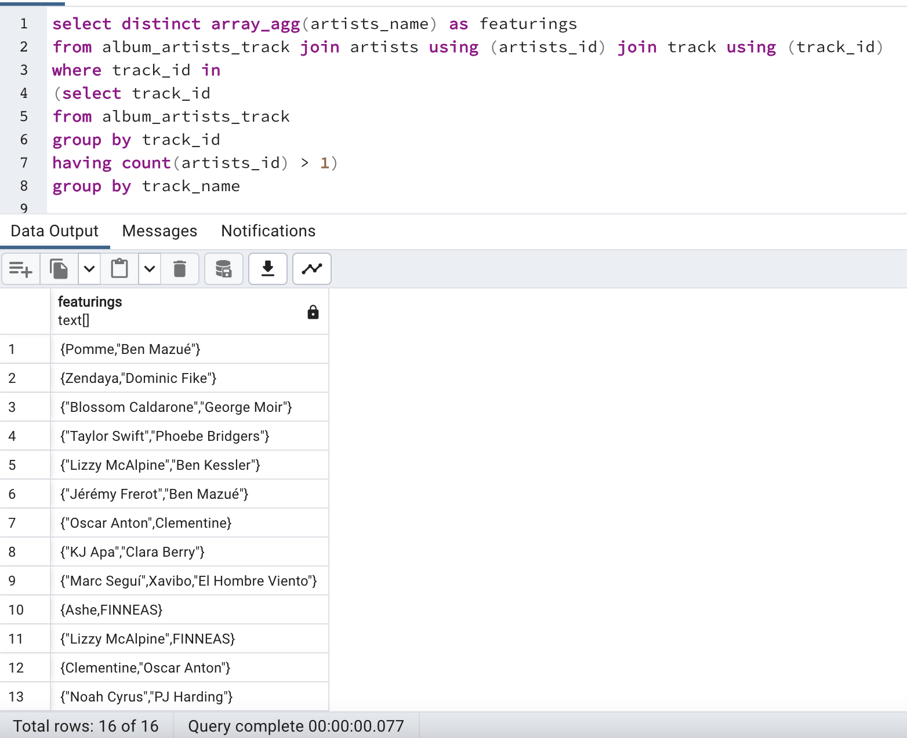
Utilization of array_agg to get the featurings

Slide 23

CONCLUSION

Slide 24
PROJECT SUMMARY
IDEAS
GOAL
API
SQL
RESULTS
From my interests to a focus on Festivals to Spotify
Via Developers space, playlist allowed me to get insights about my tastes
From the vision to actually retrieving the data, learning about Apis
Importing data, creating tables and keys, dropping and clearing
Many aspects analyze, and a lot more approaches to consider

Slide 25
ADDITIONAL REFLECTIONS
track_number
available_markets
track_duration
album_release_date
Use it to determine if the most popular song of the artists are usually first in album
Use the created column to see if songs and album are available in same markets
Analyze if longer songs are usually released as a single
Look for trends or correlations in release and popularity

Slide 26
THANK
YOU!

